Slide 1
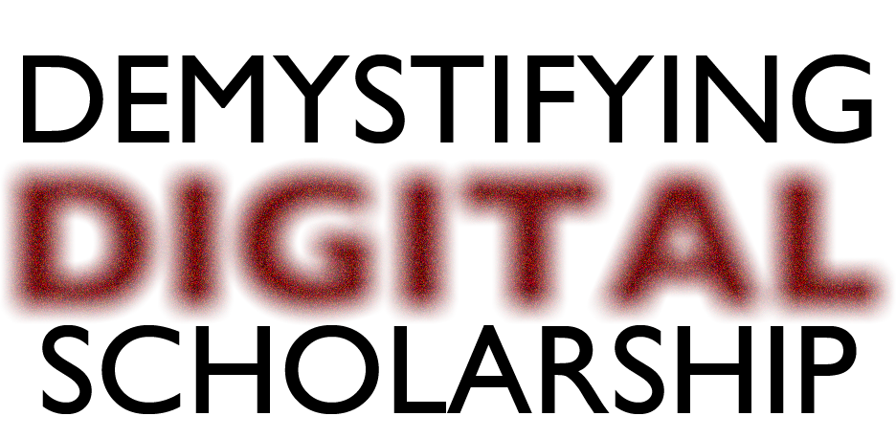
What is digital scholarship, and
why does it matter?
Paige Morgan
November 20th, 2014

Slide 2
Goals: what I can do
Provide necessary background via these workshops and Sherman Centre website, events, and staff.
Allow you to begin charting your own course, and figure out what kind of engagement you want with digital scholarship.
Make digital scholarship a safer, less intimidating, and more welcoming space for experimenting.
Start building a digital scholarship cohort at McMaster.

Slide 3
Limits: what I can’t do
CAN BECOME
A DIGITAL SCHOLAR

Slide 4
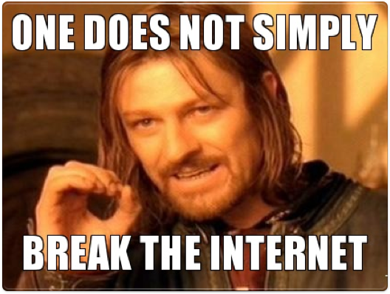
But don’t worry...

Slide 5
The point of this workshop is not to convert you to digital scholarship.

Slide 6
There is no single way of being a digital scholar.

Slide 7
Defining DS
“the use of digital evidence, [or] methods of inquiry, [or] research, [or] publication and[/or] preservation to achieve scholarly and research goals.” (Scholarly Communication Institute, University of Virginia)
By its stability, or lack thereof
By the diversity of tools and methods that are being used

Slide 8
Digital scholarship? Or Digital humanities?
Many of the tools/methods/projects in digital humanities can be adapted for digital scholarship, and vice-versa.
Primary difference: digital “stuff” may feel more unfamiliar to humanities scholars and departments — effecting the way that you frame what you’re doing.
As a result of this unfamiliarity, it may be easier to find how-to guides/tutorials by searching for “digital humanities” than DS.
Do you see a difference between the two? If so, it’s probably worth discussing further…

Slide 9
Why values?
While the tools, projects, and methods are diverse, values tend to be more consistent
The values that inform digital scholarship are key to deciding what you want to do
Understanding the values that drive digital scholarship allows you to participate in conversations whether or not you yourself identify as a digital scholar.

Slide 10
Values behind DS
(not all of these values must be present simultaneously)
adaptive
sustainable/resource-aware
multimodal
interdisciplinary
auto-didactic
collaborative
ad hoc
process & product-driven
accessible
public & transparent
project-oriented
transparency

Slide 11
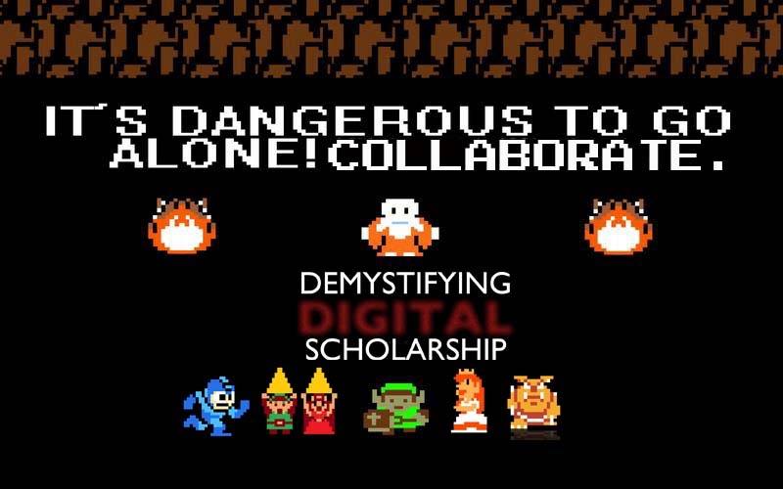
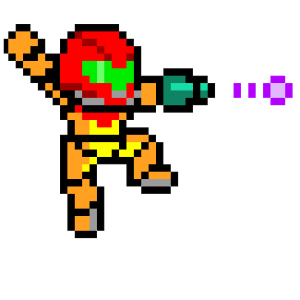

Slide 12
Websites for Evaluation
An Epidemiology of Information:
http://www.flu1918.lib.vt.edu
Mr. Seel's Garden:
http://www.mrseelsgarden.org
EvoText: http://evotext.crc.nd.edu
Mapping Microfinance:
http://ds.haverford.edu/wp/mappingmicrofinance/
Canadian Centre for Epigraphic Documents:
http://www.epigraphy.ca
www.twitter.com/feministhulk
www.theblockbot.com
http://tinyurl.com/fycchat2 and http://fycchat.blogspot.com

Slide 13
Website Evaluation Questions
What do you see as the project’s goals and/or priorities?
Which DS values do you see in operation?
What sort of usage (and user) is being posited?
What aspects (if any) aren’t working well?
Is there anything else that stands out, or raises questions for you?

Slide 14
The big question:
What do you want to do with digital scholarship?

Slide 15
Resources for further training and collaboration
Sherman Centre for Digital Scholarship: (http://scds.ca)
HASTAC (http://www.hastac.org)
DHSI (http://www.dhsi.org)
TEI Seminars at Brown University (http://www.wwp.brown.edu/outreach/seminars/)
Profhacker (http://chronicle.com/blogs/profhacker/)
Online coding courses: Skillcrush (http://www.skillcrush.com) and Codecademy (http://www.codecademy.com), many others (just google!)
Digital Humanities on Twitter -- no account needed (https://twitter.com/paigecmorgan/digital-humanities)

Slide 16

Thank you!
Next week:
Using Social Media for Learning and Professionalization

